Slide 1
Federal Mandate for
Universal EHR
Presented by:
Angelina Gambino, Anthony Guan,
Taiba Shah, Monica Benjamin, Melinda Chiu
Public Health - HPPA 516
January 23, 2019
Notes:
1)Define emr & discuss our current system
2)stats and problems of our current healthcare system / EMR
3)Discuss concept of universal emr and how it would solve those problems
4)Describe how we should go about implementing a universal system
5)Research if other countries/locations are doing so already or what others are doing

Slide 2
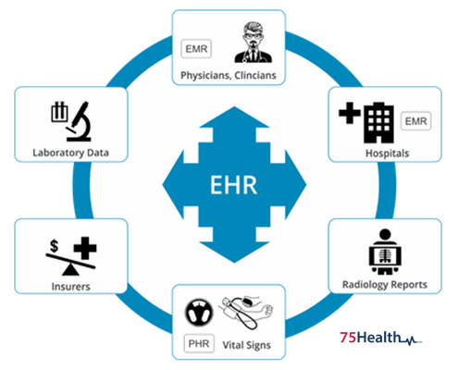
What are EHR?
Electronic Health Record
Digital equivalent of paper records or charts at a healthcare facility
Can be shared by clinicians and staff across different healthcare centers
Contain:
patient’s medical history
diagnoses
medications
treatment plans
immunizations
allergies
radiology images
laboratory results
Contain information from all clinicians involved in the patient’s care
Patient data can be tracked over a period of time
Designed to help organizations provide efficient and precise care

Slide 3
Our Current EHR System
Created in the 1970s but slow progression
In 2009 the HITECH Act was signed into law and gave providers and hospitals further incentive to use EHR technology
EHR software used in the U.S.
eClinicalWorks, Allscripts, Cerner
Epic Systems EHR
Many hospitals use this system to document patient information
Vitals, medications, lab results, health care professional notes, payments, etc
Providers can monitor their patients, submit referrals, order labs, schedule visits
Patients have access to their personal and family history information via MyChart
Message clinicians, schedule appointments
The U.S. system lacks the ability to connect to different information systems or organizations
due to U.S. issues implementing their EHR to their full capabilities
Ensuring privacy and security compliance
Training staff on new EHR
Flow of work will change

Slide 4
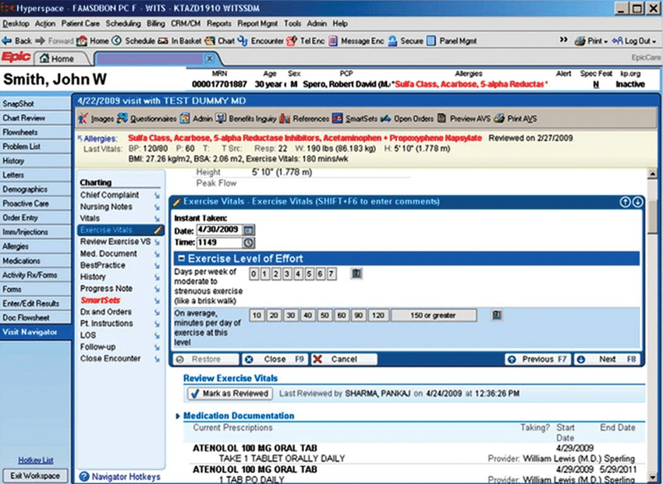

Slide 5
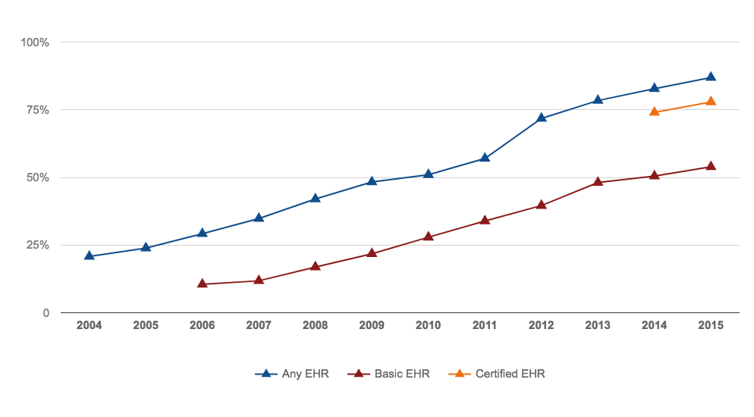
Statistics of EHR/EMR Adoption
More that 96% of hospitals have a federally tested and certified EHR
As of 2015 86.9% of office-based physicians in the US are using any EMR/EHR system
53.9% are using basic EMR
77.9% are using a certified system
Notes:
https://www.cdc.gov/nchs/data/ahcd/nehrs/2015_nehrs_web_table.pdf
https://www.cdc.gov/nchs/fastats/electronic-medical-records.htm
https://dashboard.healthit.gov/quickstats/quickstats.php
-New York Any:86.4, Basic: 48.2, Certified: 74.5
- Physician specialties with the highest adoption rates are internal medicine / pediatrics (76%), nephrology (75%), family practice (75%) and urology (74%)

Slide 6
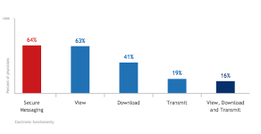
Electronic Patient Engagement Capabilities
In 2015 64% of office based physicians had an EHR that could exchange secure messages with patients and 16% of all physicians practices EHR allowed patients to view, download, and transmit information.
Notes:
Such as lab results, and patient history, and medications

Slide 7
Challenges in our Healthcare System
Patients have more complex needs and wants, and it is hard for physicians to keep up
25% of Americans have multiple chronic conditions, thus seeing multiple providers
63% of patients forget to adhere to medications.
40% of doctors feel that their work pace is chaotic.
60% of doctors feel that visits are too short to treat patients effectively.
To Decrease Costs and provide High Quality Healthcare
In 2017 U.S. Healthcare costs were $3.5 trillion and accounts for 17.9% of our GDP
Administrative costs account for over 20% of costs due to billing and antiquated fax communication
Three of every ten tests ordered are reordered because results are lost
Notes:
http://getreferralmd.com/2012/02/medical-dental-referral-letter/
https://www.visualcapitalist.com/electronic-health-records-as-a-gps-for-healthcare/

Slide 8
Problems of our Healthcare Information System
Communication
Preventable medical errors remain the 3rd leading cause of death, over 80% are due to administrative errors
Only 54% of faxed referrals where scheduled, and primary providers are unaware
In 2015 only 59% of Hospitals notified patients PCP of ER admission
Interoperability of EHRs
The average hospital has 16 different EMR systems, most have over 10 and only 2% have 1-2 systems
Only 30% of EHR exchange vital information
Notes:
Most are specialty EMR’s, with such a large number no wonder communication, duplication of care, and medical errors occur
Three in five non-federal acute care hospitals routinely electronically notify a patient’s PCP when he or she is admitted into the hospital’s ER. Only one in three notify PCPs outside of the health system. This lack of communication leads to poor care continuity.
Only 4 in 10 hospitals report that their providers can send and receive secure electronic messages withholding confidential patient health information to and from sources outside of the health system or organization.
This is troubling in today’s healthcare world as many patients see multiple providers in and out of network. For quality and transparent care to be possible, it is essential that these providers be able to communicate with each other so that they can provide the best care possible to their patients
https://www.visualcapitalist.com/electronic-health-records-as-a-gps-for-healthcare/

Slide 9
What is Universal EHR?
Universal Electronic Health Records would allow access to patient health information at every potential venue of care
Patient privacy, security and autonomy would still be preserved
It is generally agreed by everyone that technology, with access to up-to-date information on a patient's health information, is a huge step forward in health care reform
Main goal is ACCESS!
Patient information needs to be portable and accessible to appropriate care givers in different settings
Different models of Universal EHR have been suggested
A. Internet-based password protected records
B. Portable USB drives
Notes:
Ask any doctor if they can freely share digital patient records outside of their organization, or access patient information stored in another organization’s EMR, and the answer is typically a resounding “no”. This unfortunate reality perpetuates the use of fax and express or postal mail and contributes to frustration and burnout

Slide 10
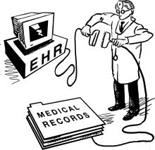
How can Universal EHRs solve problems?
Secure sharing of health information
Solves the problems that come with scattered care across multiple providers and health systems
Wider use of preventative care
Saves time for both the patient and the provider
ED providers can get a patient’s full health history
Primary care providers can receive consult notes from specialists and hospital visits to better monitor the patient
Research opportunities
Better clinical decision making
Notes:
When patients receive care from multiple providers, the sharing of their health records is either through fax, mail or simply word of mouth from the patient.
Universal EMRs provide a secure way to share health records, allows for communication between providers and integrate care
It’s very difficult for physicians and other frontline caregivers to get complete pictures of patients’ healthcare, of course, since patients so often receive care at multiple locations whose IT systems may not be interoperable.
Less paper work for the provider, the patient doesn't have to provide whole run down of their medical history when they change providers
Emergency Department providers can a whole view of a patient’s history to better treat them. This is a big benefit especially when the patient is in a state where they cant give history,
By having a unified, national EMR system it can facilitate the aggregation of an enormous amount of medical information that would become a valuable database that can be used in research
It would have help advance our medical knowledge, and move evidence-based medicine forward
By having integrating patient information from multiple sources and having all the information accessible will foster better clinical decision making

Slide 11
How can Universal EHRs solve problems?
A major issue in our current healthcare system is costs
Universal EMRs can reduce costs in the short term and long term
Reduces redundant unnecessary testing, which prevents inconvenience/ pain for the patient→ reducing costs for :
Patients
Insurers
Care providers
Reduces Medical Errors
Notes:
~Universal EMRs will reduce costs through decreased paperwork, improved safety, reduced duplication of testing, and improved health.
~Patients and insurances don't have to pay for unnecessary testing and procedures if the provider has access to all their health information and they can see the results of the tests that already have been done
~A universal system that provides access across venues and can aggregate patient data, will create cost savings by promoting better outcomes that translate to less utilization of overall resources
While it will be costly to implement a universal EMR, these costs will be overpowered by the saving from decrease use of resources, and reductions in chronic illnesses due to improvements in preventative medicine

Slide 12
Do we have anything similar to Universal EHRs
already in the states?
Georgia Health Information Network (GaHIN)
“Statewide network-of-networks health information transport model”
Nearly 20 years of planning and arranging
Required multiple parties
GaHIN’s Board of Directors
Georgia Department of Community Health (DCH) grant
Georgia Health Information Technology Extension Center (GA-HITEC)
Other State and federal agencies, strategic partners
What can this mean for US?
Programs like GaHIN already exist in states.
Stepping stone to implementing something similar across the country.
Notes:
http://gahin.org/about-gahin/
CRISP (Chesapeake Regional Information System for our Patients)
Maryland’s statewide exchange of radiological images, clinical data and laboratory data to treat stroke (why?)
CRISP team - stroke specialist, neuroradiologist and stroke resident
diagnoses and collaborates with emergency team
improves outcomes by “accelerat[ing] the diagnostic process and dramatically reduces the time to treatment”
Saved an average of 56 minutes

Slide 13
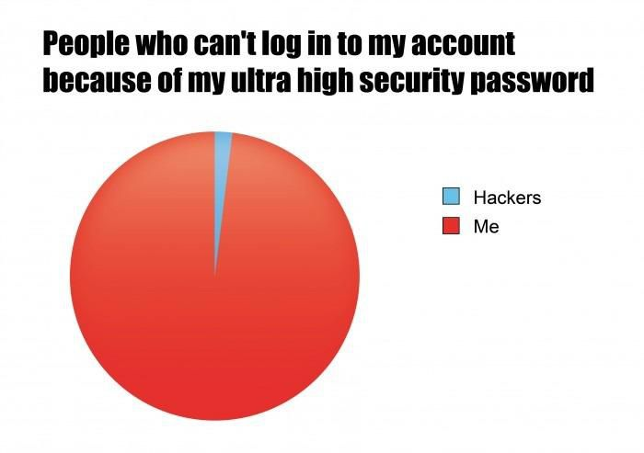
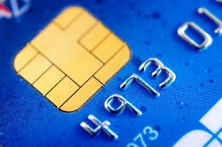
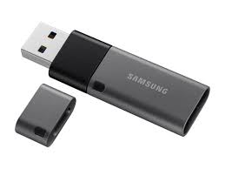
Our Plan to Implement a Universal EHR
Not a quick fix
Needs years of development & testing
Federally mandate all healthcare facilities to utilize the universal EHR
3 methods to access patient records
Patient Health Password (PHP)
Known by patient and clinicians
License smart chip
Unconscious patients, etc.
USB flash drive given to patient
Only works on program in medical facilities
Notes:
We want to make it clear that this won’t be easy
First we would need to make a very efficient and strong program, able to resist malware and other methods. We would spend years testing and improving this software before implementing it because it’s essential to have a near perfect system when operating with people’s health records.
It would also be necessary to make this a federal mandate that all facilities will use this. This is essential because if many facilities are not participating, the patient’s health record will not be complete. For example, an ER doctor will want to see the PCP’s files but the PCP dies not participate.
We would have 3 methods for a clinician to access this, as without some kind of password or barrier, any one in healthcare would be able to access anyone’s records. First would be a Patient Health Password (PHP). The patient would know this number and could give it to a clinician or hospital upon arrival, just like an insurance number.
For times when a patient cannot provide the number, the patient’s EHR could be accessed by scanning a smart chip that would be present in the person’s driver’s license or other form of ID.
A USB flash drive would also be given to the patient so that he or she could always have their information, however the information would only be able to be accessed on a program only available in medical facilities, so the patient cannot see his or her own information.

Slide 14
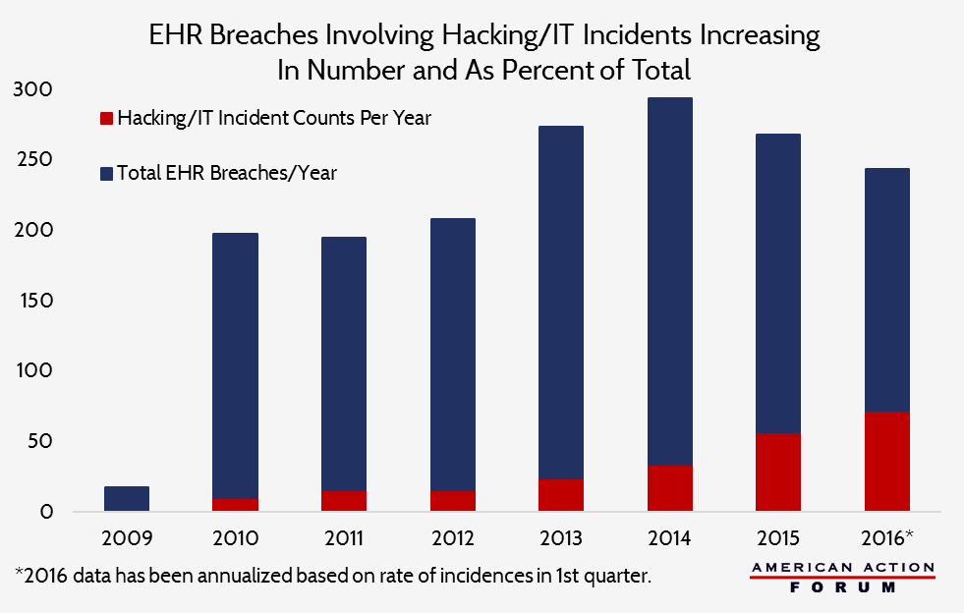
Universal Records, Universal Risk
Department of Health and Human Services: "the rise in the adoption rate of these technologies [electronic health records] increases the potential security risks."
Black market value of health records
EHR breaches are common and widespread
Protenus Breach Barometer Findings
“5,579,438 patient records were breached in 2017”
2017’s largest breach→ “Kentucky hospital employee inappropriately accessing the billing information of 697,800 patients”
37% of 2017 breaches were the result of an employee’s wrongdoing
HIPAA violations
Notes:
The Department of Health and Human Services says "the rise in the adoption rate of these technologies [electronic health records] increases the potential security risks." so inevitably with the advancement of technology also comes the advancement of cybersecurity risk
We constantly hear about stolen credit cards and social security numbers landing on the black market. However, the real danger is stolen health records. According to Forbes, the black market rates are as follows: 10 cents for a social security number, 25 cents for a credit card number, and hundreds to thousands for a stolen EHR. Think about it, prominent congressman cheats on his wife again and now has contracted an STD, his EHR is stolen and he is blackmailed for what should be private and protected. Also, when your credit card is stolen, you find out pretty quick. Hackers may have access to your EHR and not act on it for years.
Read Protenus stuff→ because insider breaches are so common, a proposal like this could exacerbate the situation. With healthcare employees being able to access even more information and a system that carries all the information about everyone, this could be a major target for both internal and external breaches, leading to obvious HIPAA violations. Thus, as we mentioned before it would be essential to ensure that the technology was thoroughly tested before implementation, as well as a team to constantly strengthen the technology and protect it from hacker’s advancing methods.
https://www.nbcnews.com/news/us-news/thousands-patient-records-leaked-hospital-data-breach-n756981
https://www.forbes.com/sites/mariyayao/2017/04/14/your-electronic-medical-records-can-be-worth-1000-to-hackers/#7b4a5c9c50cf
https://www.protenus.com/press/press-release/56m-patient-records-breached-in-2017-as-healthcare-struggles-to-proactively-protect-health-data

Slide 15
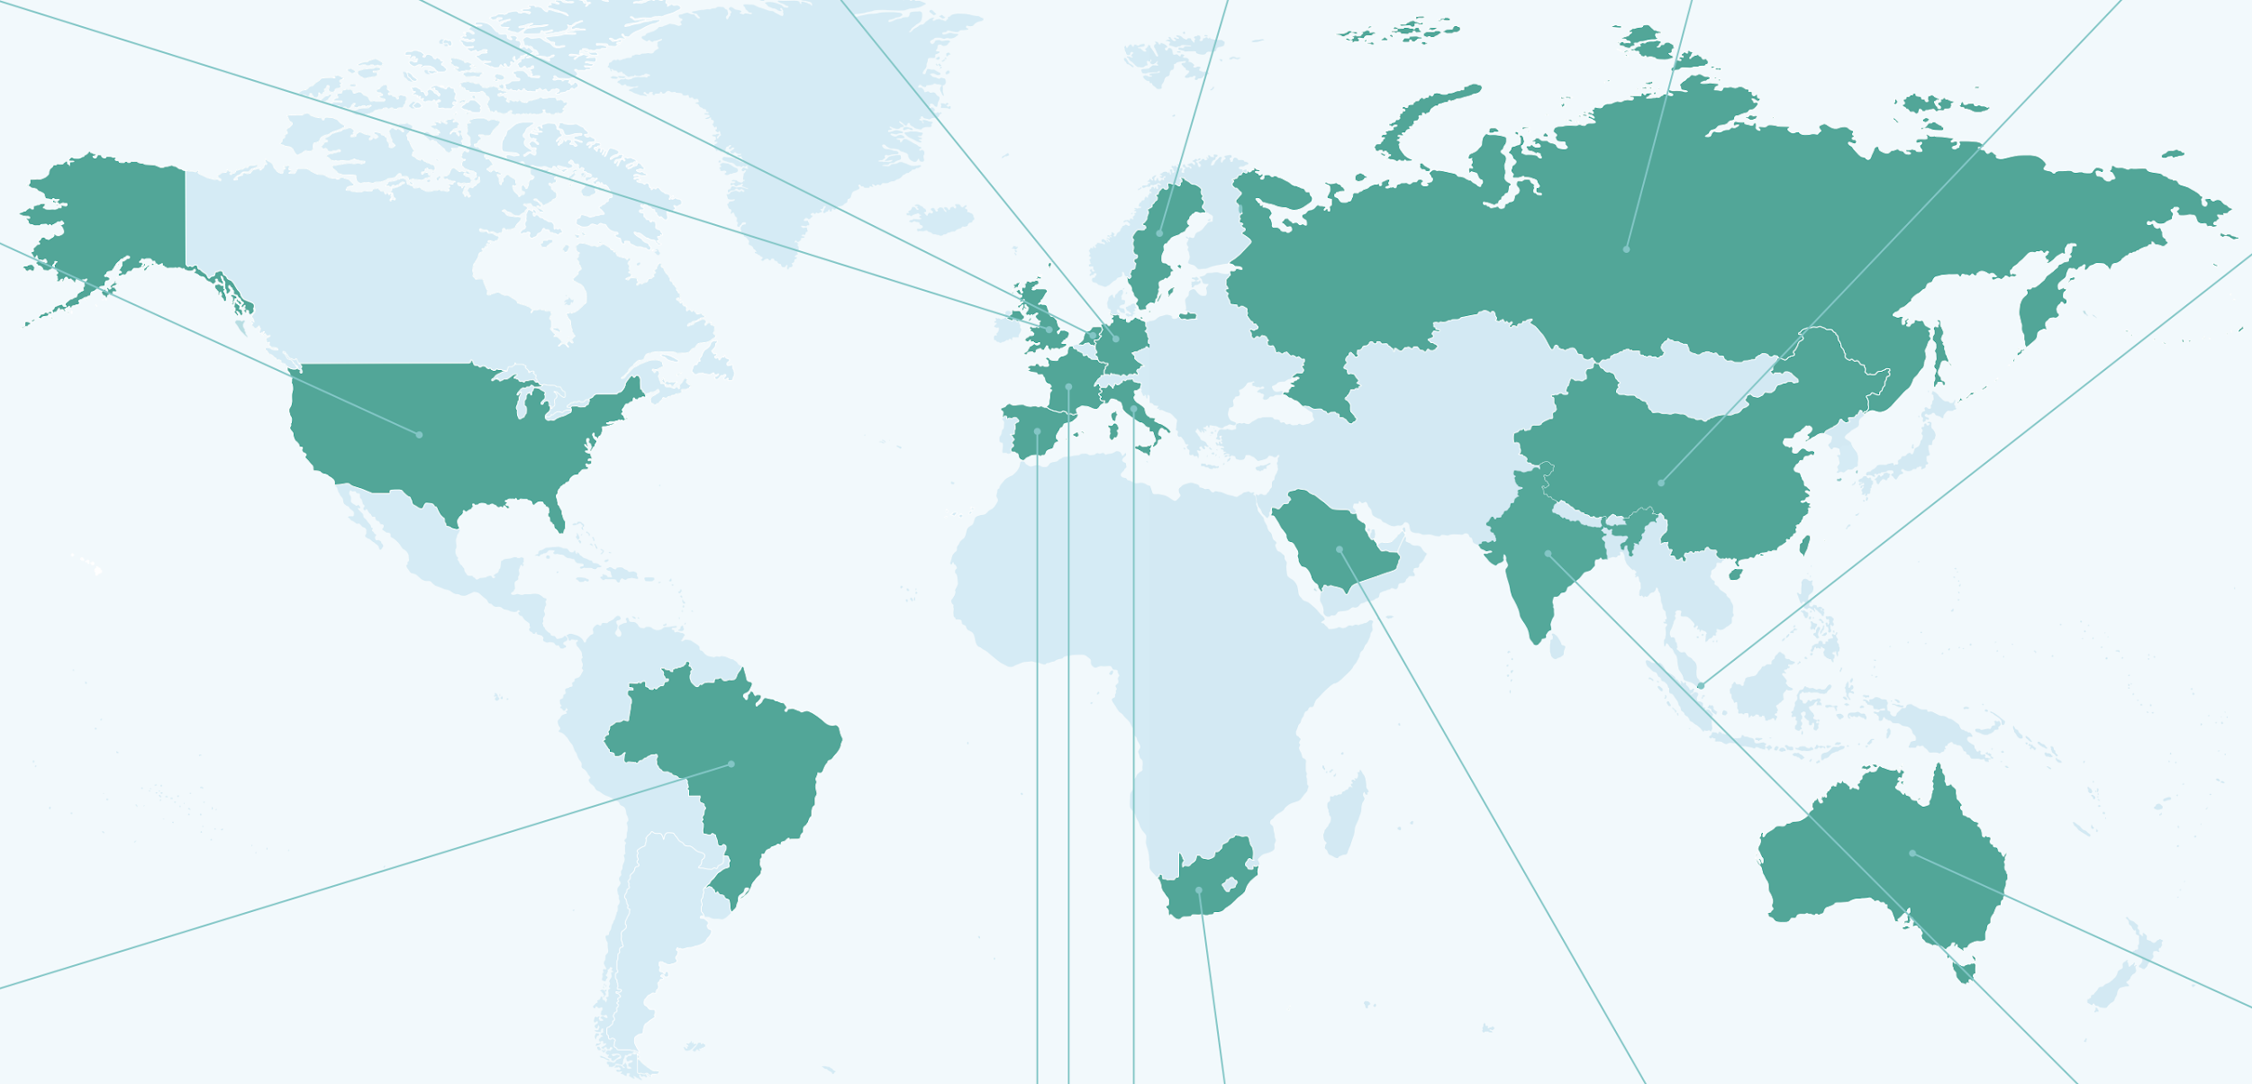
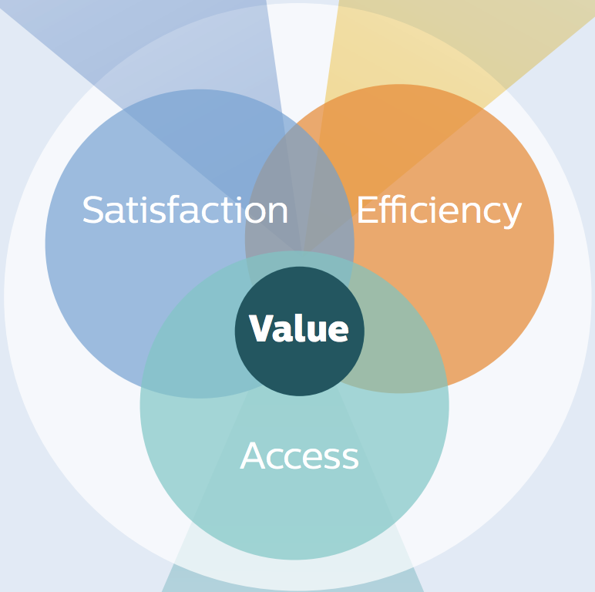
Are other countries using Universal EHRs?
Royal Philips - Future Health Index (FHI)
Value Measure (access, satisfaction, efficiency)
“benchmark against which a system’s progress towards efficient and effective healthcare can be evaluated.”
Connected Care Technology
Data collection and analytics - EHR, Wearables, Artificial Intelligence
Care delivery - Telehealth, Diagnostic and Treatment Technology
Encourage countries to review and make improvements
Notes:
global leader in health technology
FHI will encourage countries to question existing practices and take the steps needed to shape health systems that are efficient, effective and fit for purpose for years to come
Compiled data on how 16 countries deliver health care
represents roughly half of the world population
Access i.e. how universal and affordable is access to healthcare?
Satisfaction i.e. to what extent do the general population and practitioners in each market see their healthcare system as trustworthy and effective?
Efficiency i.e. does the system produce outcomes at an optimum cost?
Diagnostic and Treatment Solutions (Imaging, Image-guided Therapy, assisted surgery technology)
Telehealth - deployed to broaden access to remote areas in countries as diverse as India; enabling technicians to act as a proxy for doctors in rural villages by conducting basic diagnostic tests, and the US; remote patient monitoring and virtual consultations
Image-guided therapy, a central concept of 21st century medicine, is the use of any form of medical imaging to plan, perform, and evaluate surgical procedures and therapeutic interventions
Source: https://www.philips.com/a-w/about/news/archive/standard/news/press/2018/20180614-philips-commissioned-future- health-index-outlines-journey-to-value-based-healthcare.html
Source: http://images.philips.com/is/content/PhilipsConsumer/Campaigns/CA20162504_Philips_Newscenter/future-health-index- report-2018-part-one-building-systems-for-better-outcomes.pdf

Slide 16
Are other countries using Universal EHRs?
Australia, Brazil, China, France, Germany, India, Italy, Netherlands,
Russia, Saudi Arabia, Singapore, South Africa, Spain,
Sweden, United Kingdom, United States
Countries without Universal EHR average Value Measure = 39.67
lower trust in health system
(e.g. US satisfaction = 45%, Efficiency ratio = 13%)
Countries with Universal EHR average Value Measure = 47.29
higher trust in health system
(e.g. Singapore satisfaction = 68% (82% professionals); Efficiency ratio = 50%)
belief that integration of health systems is important
High Value Measure = connected care technology & satisfaction
High Data collection and analytics rates = health professional’s trust
China - highest rates of fitness wearables
Saudi Arabia, South Africa*, Brazil and India - lowest rates of EHRs
Notes:
Source: https://healthitanalytics.com/news/are-universal-ehrs-key-to-healthcare-value-trust-and-ai-adoption
http://images.philips.com/is/content/PhilipsConsumer/Campaigns/CA20162504_Philips_Newscenter/future-health-index- report-2018-part-one-building-systems-for-better-outcomes.pdf

Slide 17
Are other countries using Universal EHRs?
The Lancet - Healthcare Access and Quality (HAQ) Index
Norway #2
Netherlands #3
Australia #5
Italy #9
New Zealand #16
Germany #18
Spain #19
France #20
Singapore #22
United Kingdom #23
USA #29
➤ universal EHR
➤ near-universal EHR
➤ USA
Notes:
China #48 high efficiency due to low healthcare spending, okay satisfaction, below-average outcomes
Below average healthcare professional density, and above-average risk of impoverishment due to surgical care
Lack policies or regulations in place governing data protection and sharing
Russia #58 had low data collection and analytics score
Healthcare Access and Quality (HAQ) Index
32 causes considered amenable to health care comprise the HAQ Index, representing a range of health service areas: vaccine-preventable diseases; infectious diseases and maternal and child health; non-communicable diseases, including cancers, cardiovascular diseases, and other non-communicable diseases such as diabetes; and gastrointestinal conditions from which surgery can easily avert death (eg, appendicitis)
Source: https://healthitanalytics.com/news/are-universal-ehrs-key-to-healthcare-value-trust-and-ai-adoption
https://www.thelancet.com/action/showPdf?pii=S0140-6736%2818%2930994-2

Slide 18
Are other countries using Universal EHRs?
Australia - My Health Record
Clinicians and patients can add
Singapore - Integrated Health Information Systems (IHiS)
Allows communication between EHR systems
Germany
Nationwide EHR
United Kingdom
England, Northern Ireland, Scotland, and Wales - common EHR system in primary care settings
Italy - New Health Information System
Connects hospitals, EMS , outpatient specialists, etc; but not primary care
Gives information on services, resources used, costs
Notes:
Source: https://www.myhealthrecord.gov.au/for-you-your-family/whats-in-my-health-record
https://www.philips.com/a-w/about/news/archive/future-health-index/articles/20180709-secrets-singapores-success-connected-care-technology-improving-healthcare-value-day-to-day-basis.html
https://international.commonwealthfund.org/countries/italy/
https://ogilvychww.com/thoughts/articles/3-things-ehr-eu

Slide 19
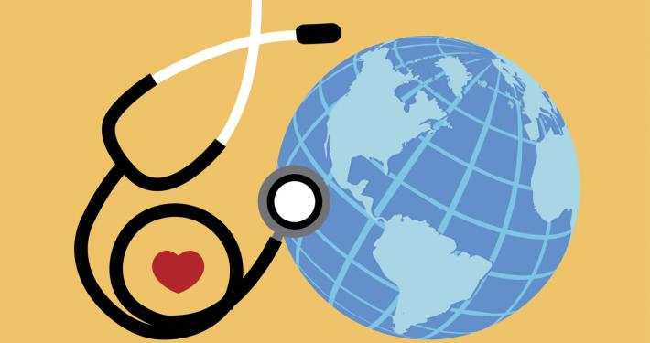
Conclusion
Let’s learn from other countries (or from programs like Georgia’s).
It will take time and effort from multiple organizations but it is worth it!
Implementing a Universal EHR will increase access, communication, satisfaction, efficiency, and lower chances of medical errors.
Let’s fix our healthcare system and implement Universal EHR!

Slide 20
References
https://www.philips.com/a-w/about/news/archive/standard/news/press/2018/20180614-philips-commissioned-future- health-index-outlines-journey-to-value-based-healthcare.html
http://images.philips.com/is/content/PhilipsConsumer/Campaigns/CA20162504_Philips_Newscenter/future-health-index- report-2018-part-one-building-systems-for-better-outcomes.pdf
https://healthitanalytics.com/news/are-universal-ehrs-key-to-healthcare-value-trust-and-ai-adoption
https://www.thelancet.com/action/showPdf?pii=S0140-6736%2818%2930994-2
https://www.myhealthrecord.gov.au/for-you-your-family/whats-in-my-health-record
https://www.philips.com/a-w/about/news/archive/future-health-index/articles/20180709-secrets-singapores-success-connected-care-technology-improving-healthcare-value-day-to-day-basis.html
https://international.commonwealthfund.org/countries/italy/
https://ogilvychww.com/thoughts/articles/3-things-ehr-eu
https://www.healthit.gov/faq/what-are-advantages-electronic-health-records
https://www.itnonline.com/article/hie-based-image-exchange-saves-lives-and-money
http://gahin.org/about-gahin/
https://www.usfhealthonline.com/resources/key-concepts/what-are-electronic-medical-records-emr/
https://www.healthit.gov/buzz-blog/electronic-health-and-medical-records/emr-vs-ehr-difference
https://www.nbcnews.com/news/us-news/thousands-patient-records-leaked-hospital-data-breach-n756981
https://www.forbes.com/sites/mariyayao/2017/04/14/your-electronic-medical-records-can-be-worth-1000-to-hackers/#7b4a5c9c50cf
https://www.protenus.com/press/press-release/56m-patient-records-breached-in-2017-as-healthcare-struggles-to-proactively-protect-health-data
https://www.ncbi.nlm.nih.gov/pmc/articles/PMC3088297/
https://www.cdc.gov/nchs/fastats/electronic-medical-records.htm
https://www.statista.com/statistics/829500/electronic-health-record-access-us/
https://www.epic.com/software#Clinicals
https://www.capterra.com/infographics/top-emr-software
https://www.himss.org/library/interoperability-standards/what-is

